Slide 1

Customer Shopping Behavior Analytics and Business Intelligence Dashboard
Customer Purchase Behavior Analytics Dashboard
Presented by-
Akshitha Yasala

Slide 2

Agenda
Business Problem
Problem Statement
Project Objective
Project Flow
Dataset Overview
Exploratory Data Anlaysis
MySQL Analysis
Power BI Dashboard Overview
Business Insights
Recommendations
Conclusion

Slide 3
Business Problem
Customers and businesses face challenges in understanding shopping behavior because:
Large volumes of customer purchase data are generated daily
Customer buying patterns are difficult to identify
Seasonal demand trends are not clearly understood
Retail businesses also need insights into:
Revenue growth opportunities
Customer experience and satisfaction improvement
Business growth and profitability optimization

Slide 4
Problem Statement
Retail organizations generate vast amounts of customer transaction data; however, transforming this raw data into reliable insights requires effective data preprocessing, cleaning, and transformation using NumPy and Pandas.
Gaining a deeper understanding of customer purchasing behavior, product preferences, discount effectiveness, membership engagement, and sales patterns requires comprehensive Exploratory Data Analysis (EDA), MySQL-based data querying, and analytical techniques.
To support strategic decision-making, businesses need interactive visualizations and Power BI dashboards that deliver actionable insights for enhancing customer retention, optimizing marketing and sales strategies, and driving sustainable business growth.

Slide 5
Project Objective
Data Collection: Gathered customer shopping behavior data from a secondary data source.
Data Preprocessing & EDA: Cleaned, transformed, and analyzed data using NumPy and Pandas.
Statistical Analysis: Performed descriptive statistics and hypothesis testing to validate key insights.
MySQL Analysis: Used SQL queries to explore data and extract business insights.
Power BI Visualization: Created interactive dashboards and visualizations for data-driven decision-making.

Slide 6
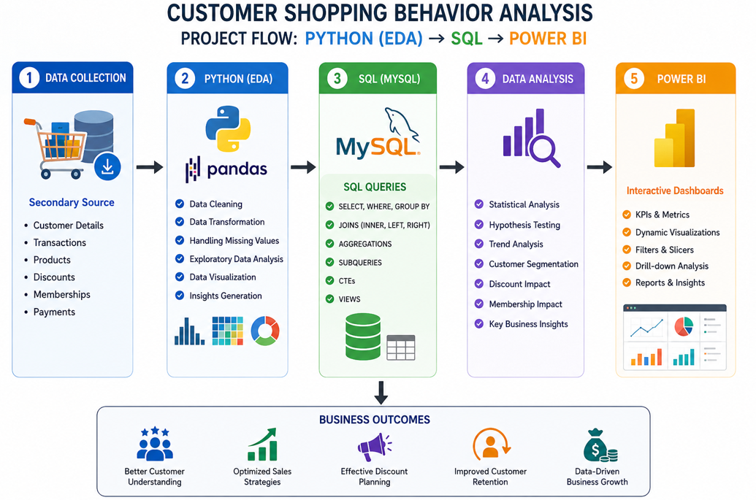
Project Flow
Raw Dataset
↓
Data Cleaning
↓
Data Transformation
↓
MySQL Storage
↓
EDA using Python
↓
Business Insights
↓
Power BI Dashboard

Slide 7
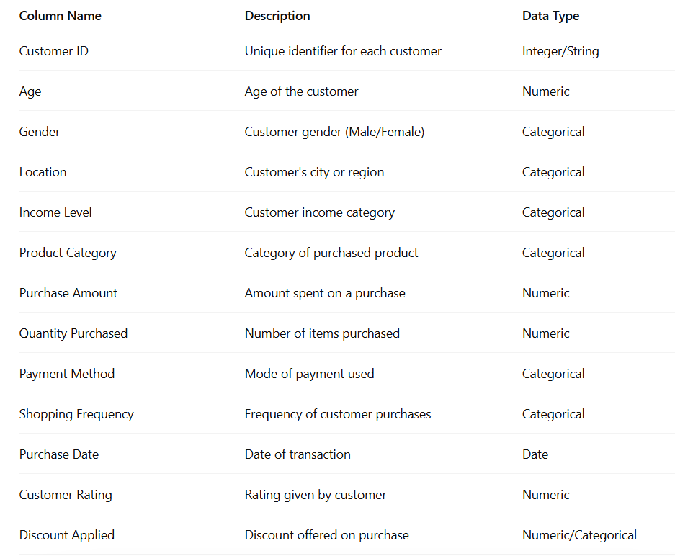
Dataset Overview

Slide 8
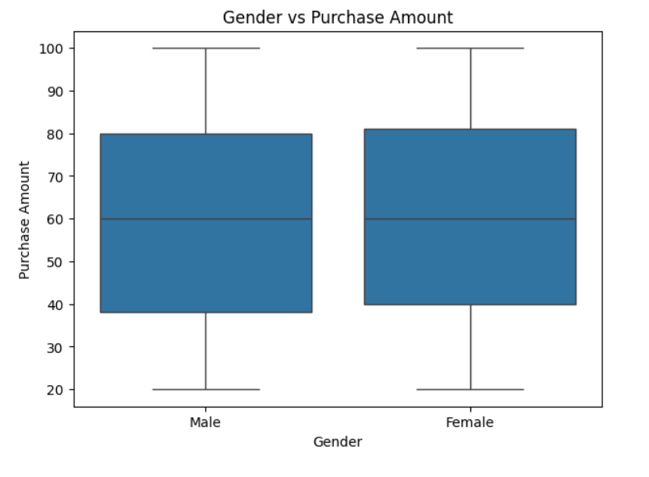
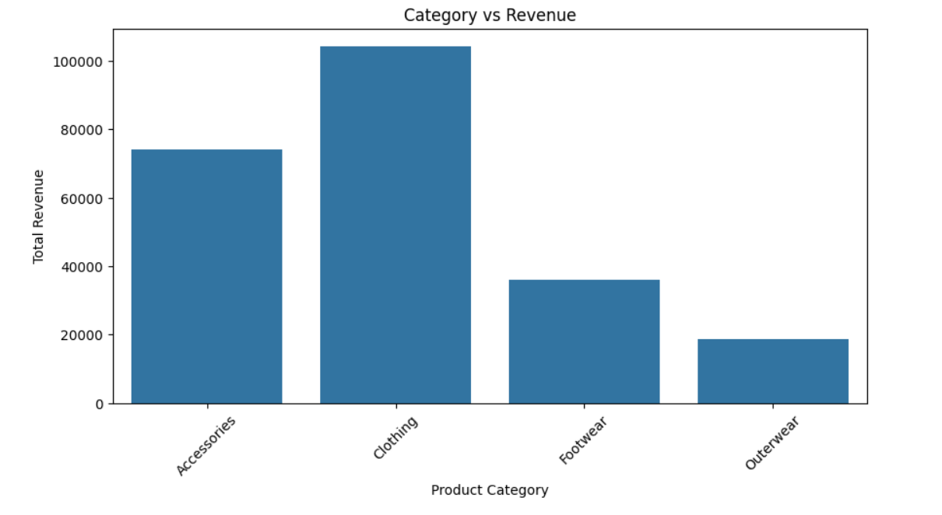
Bivariate Analysis
Gender vs Purchase Amount: Compared spending behavior across genders to identify differences in average purchase amounts.
Product Category vs Revenue: Analyzed which product categories generate the highest revenue and contribute most to sales.
Business Insight: Revealed relationships between customer demographics and purchasing behavior, supporting targeted marketing and product strategies.

Slide 9
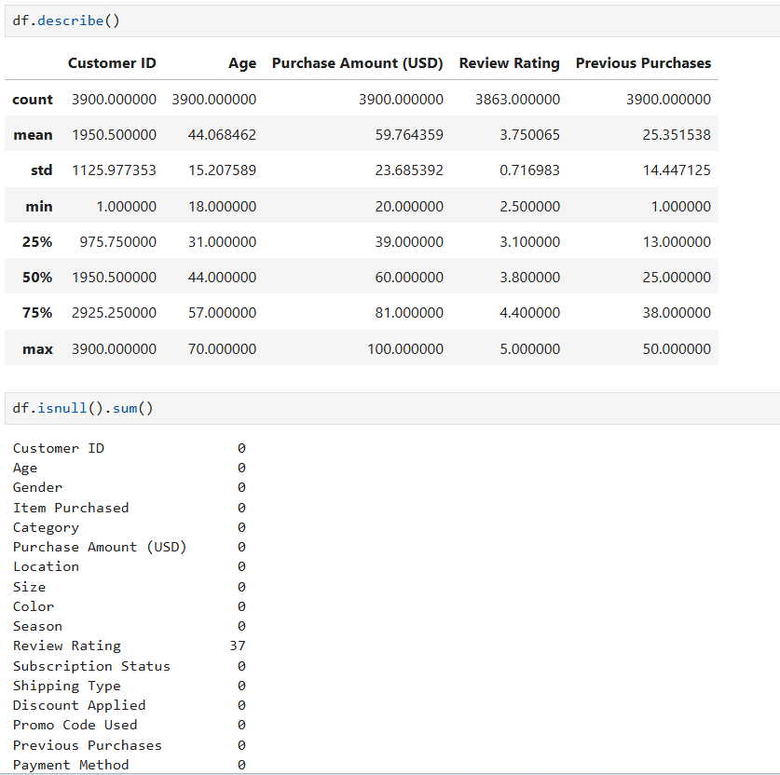
Exploratory Data Analysis(EDA)
Data Preprocessing
Checked dataset structure using:
.info()
.describe()
.isnull()
Handled missing values using:
Median, Mean, Mode
Removed duplicate records
Converted columns into proper data types

Slide 10
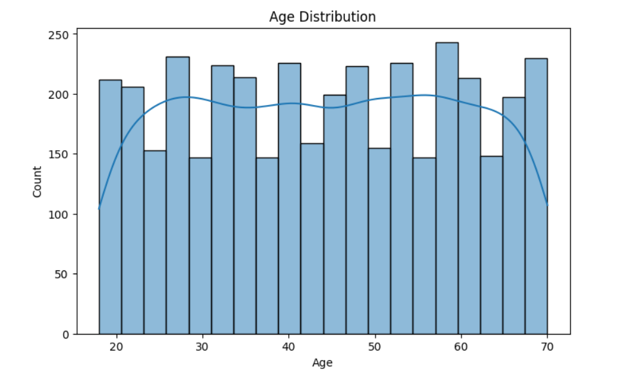
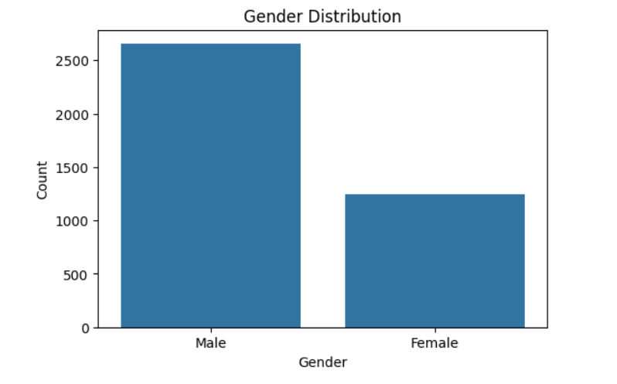
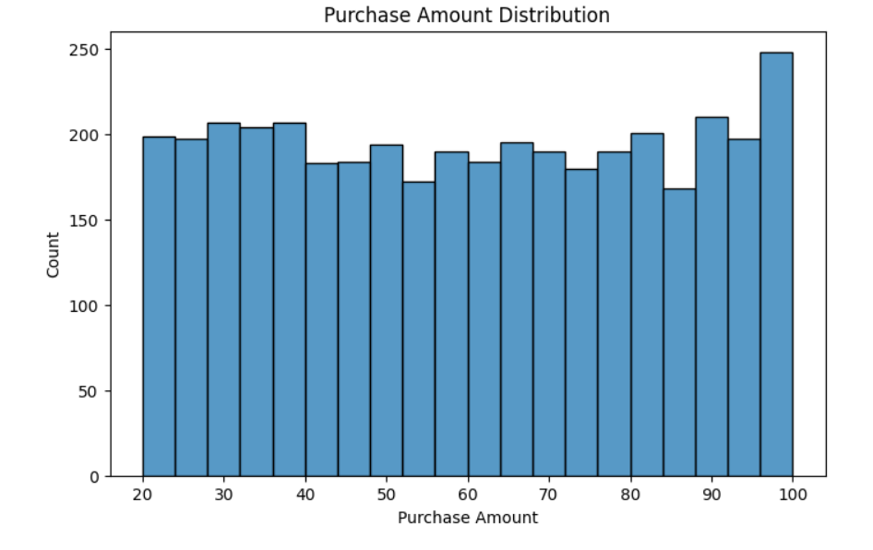
Univariate Analysis
Age Distribution: Most customers belong to specific age groups, helping identify the primary target audience for marketing campaigns.
Purchase Amount Distribution: Purchase amounts are concentrated within certain ranges, indicating typical customer spending behavior.
Gender Distribution: The dataset shows the proportion of male and female customers, providing insights into customer demographics.
Business Insight: Understanding individual variables such as Age, Purchase Amount, and Gender helps businesses design personalized promotions and improve customer engagement.

Slide 11
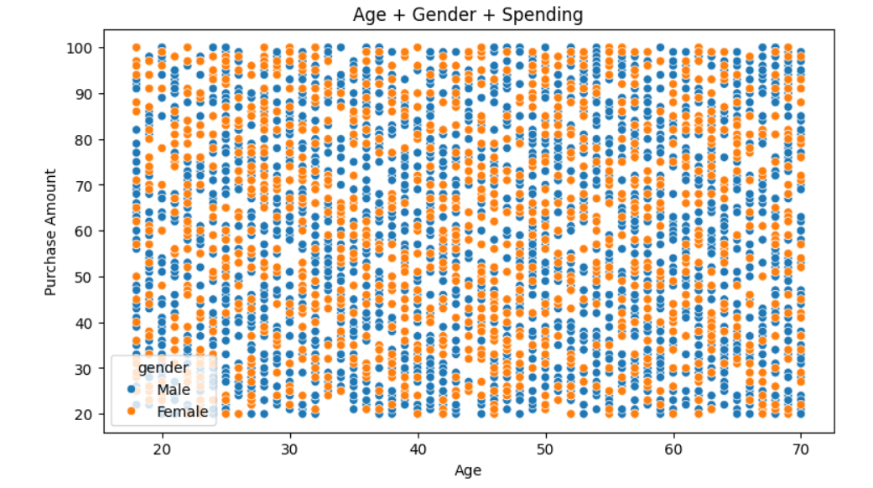
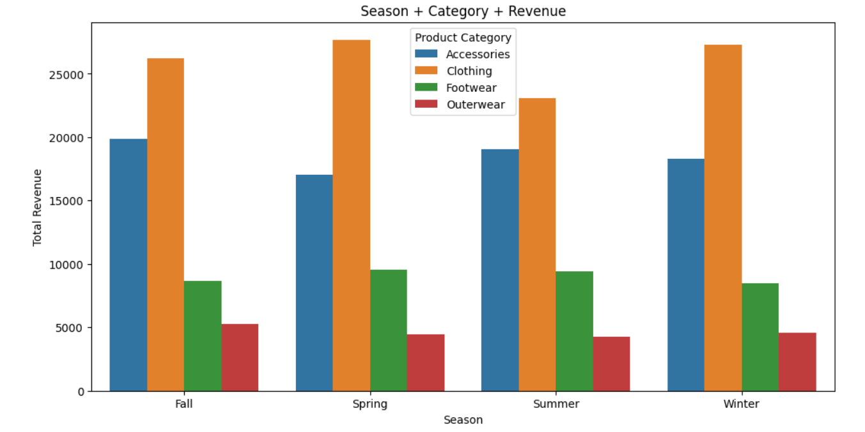
Multivariate Analysis
Age + Gender + Spending: Analyzed how customer age and gender together influence purchase amounts and spending patterns.
Season + Category + Revenue: Examined the combined impact of seasonal trends and product categories on revenue generation.
Business Insight: Helped identify high-value customer segments and seasonal product preferences, enabling data-driven marketing and inventory decisions.

Slide 12
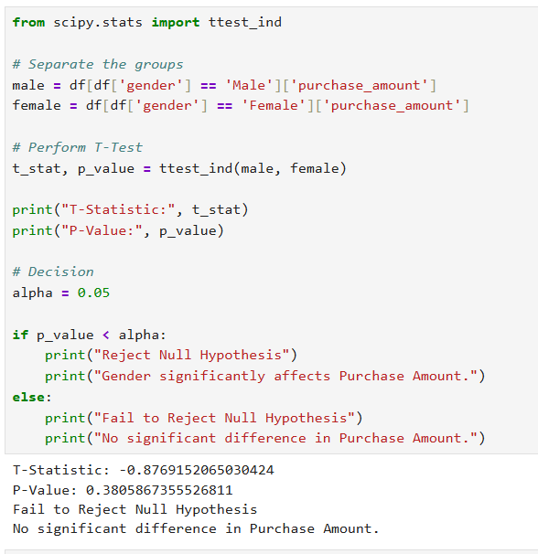
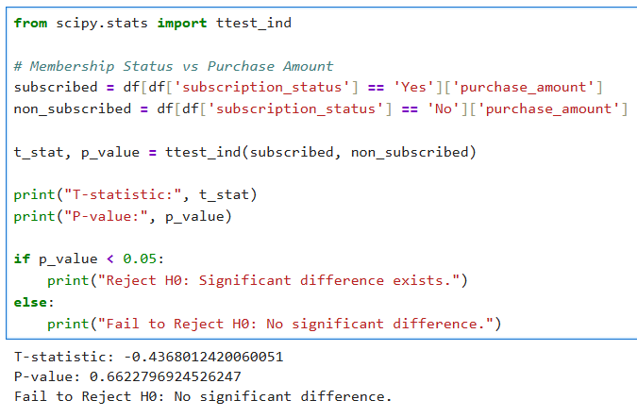
Hypothesis Testing
Hypothesis Test 1: Do Subscribed Customers Spend More?
Question - 1
Does Membership Status affect Purchase Amount?
Null Hypothesis (H₀)
There is no significant difference in purchase amounts between subscribed and non-subscribed customers.
Alternative Hypothesis (H₁)
There is a significant difference in purchase amounts between subscribed and non-subscribed customers.
Test Used
Independent Sample T-Test
Condition
Two independent groups (Subscribed vs Non-Subscribed)
Purchase Amount is numerical
Hypothesis Test 2: Does Gender Influence Purchase Amount?
Question - 2
Is there a significant difference in spending between male and female customers?
Null Hypothesis (H₀)
Average purchase amount is the same for both genders.
Alternative Hypothesis (H₁)
Average purchase amount differs between genders.
Test Used
Independent Sample T-Test
Condition
Gender is categorical
Purchase Amount is numerical

Slide 13
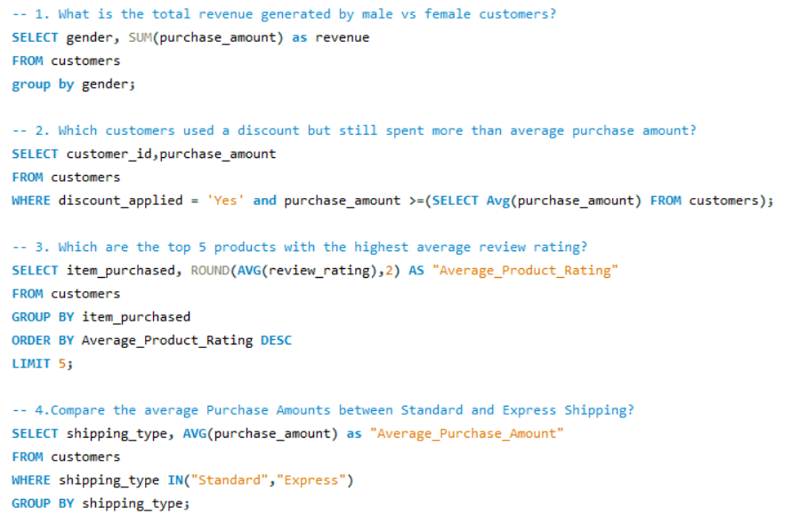
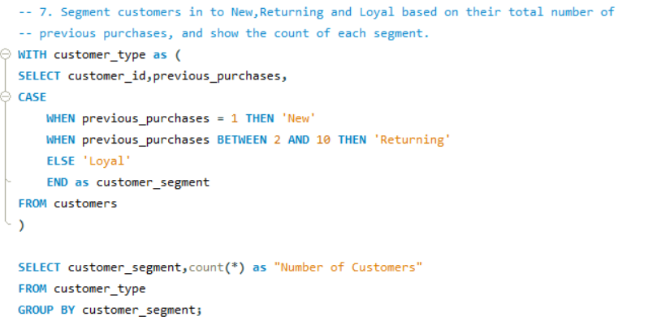
MySQL Analysis
SQL Queries Performed
Top Revenue Categories
Customer Segmentation
Seasonal Sales Analysis
Subscription-Based Revenue
Average Purchase Analysis
SQL Concepts Used
GROUP BY
ORDER BY
Aggregate Functions
Window Functions
CASE Statements
Stored Procedures

Slide 14
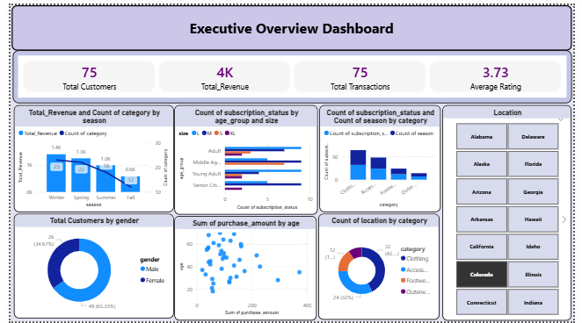
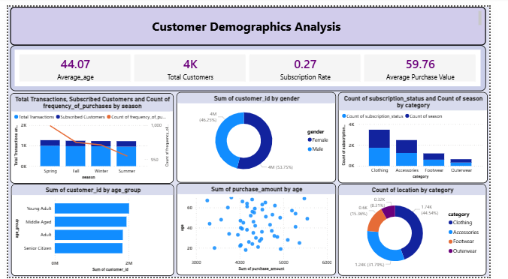
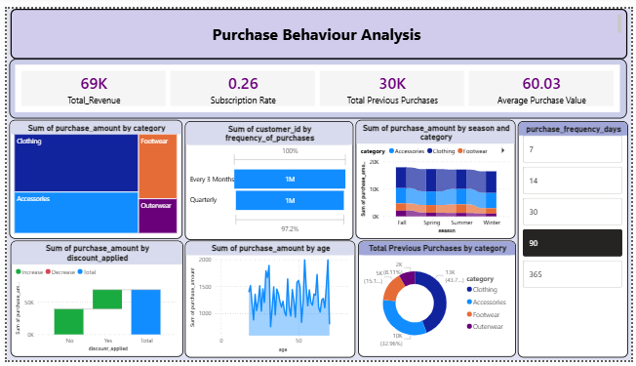
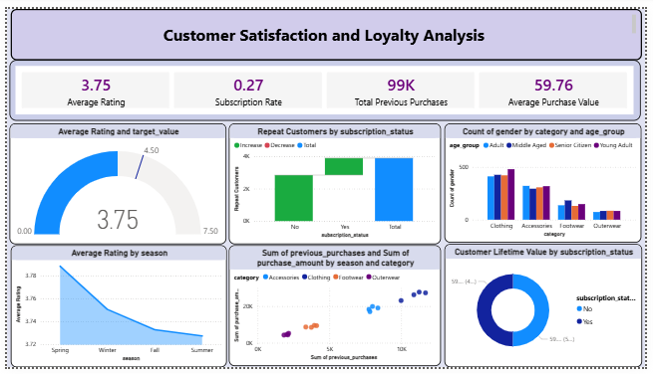
Power BI Dashboard Overview
Created 4 Interactive Dashboards
Executive Sales Overview
Customer Demographics Analysis
Shopping Behavior Analysis
Customer Satisfaction & Loyalty Analysis

Slide 15
Key Business Insights
High-performing product categories emerged as major revenue drivers, contributing significantly to overall sales.
Seasonal trends had a noticeable impact on purchasing patterns, with certain seasons recording higher customer activity and sales.
Higher customer review ratings were associated with increased purchase amounts, indicating a strong relationship between customer satisfaction and sales performance.
Repeat customers contributed a substantial portion of total revenue, highlighting the importance of customer retention and loyalty programs.
Customer demographics such as age, gender, and location influenced shopping preferences and spending behavior, enabling opportunities for targeted marketing strategies.

Slide 16
Recommendations
Focus marketing on high-spending customer segments.
Improve loyalty/subscription programs.
Increase inventory during peak seasons.
Target personalized promotions.
Enhance customer experience to improve ratings.

Slide 17
Conclusion
• Converted raw data into meaningful business insights.
• Performed analysis using Python, Pandas, NumPy, and MySQL.
• Built interactive Power BI dashboards for decision-making.
• Identified key customer behavior and spending patterns.
• Discovered major revenue drivers and sales trends.
• Suggested strategies to improve customer retention and business growth.

Slide 18


Slide 19


